Slide 1
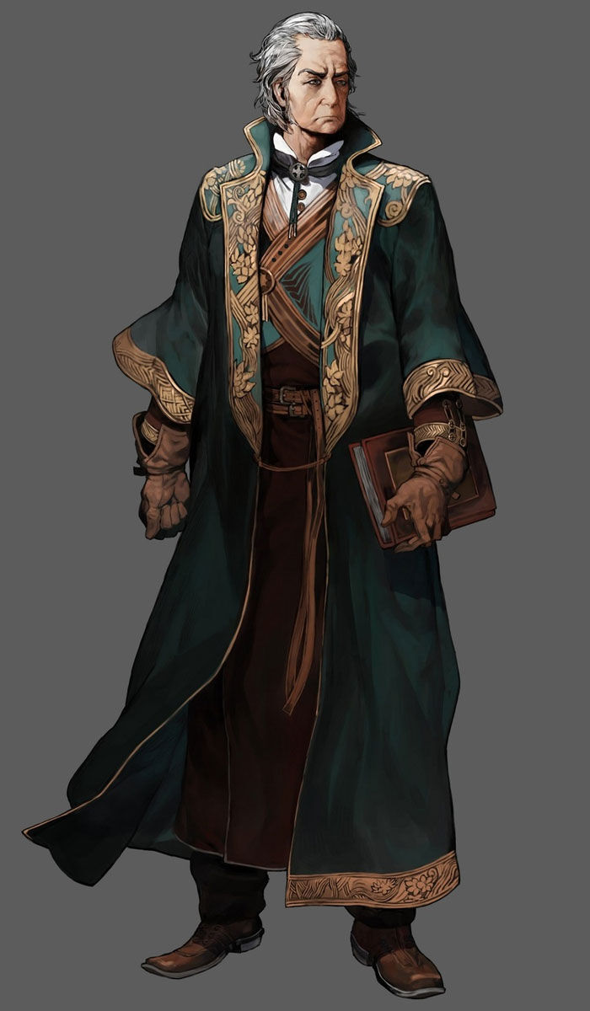
Ostaram Dashkev
Human
The Governor of Basinhold.
Notes:
1 - Ostaram Dashkev (Governor)
2 - Akna Firahel (Head Guard)
3 - Colin Tallstag (Lawmaker)
4 - Lenett Laumee (Barkeeper)
5 - Ilikan Laumee (Bar Chef)
6 - Thalaman Laboda (Dealer/Croupier)
7 - Reddlepop Pilwicken (Head Chef)
8 - Pradir Nalambar (Inn Owner)
9 - Kuori Kalagiano (Blacksmith)
10 - Balifra Torevir (Magical Imbuer/Manipulator)
11 - Thervan Hanali (Magical Market Owner)
12 - Tanzim Hanali (Magical Market Son)
13 - Chand Avhoste (Bishop)
14 - Soveliss Pashar (Patriarch 1)
15 - Gennifer Caerdonel (Patriarch 2)
16 - Jabba (Nishi Waters Watcher)

Slide 2
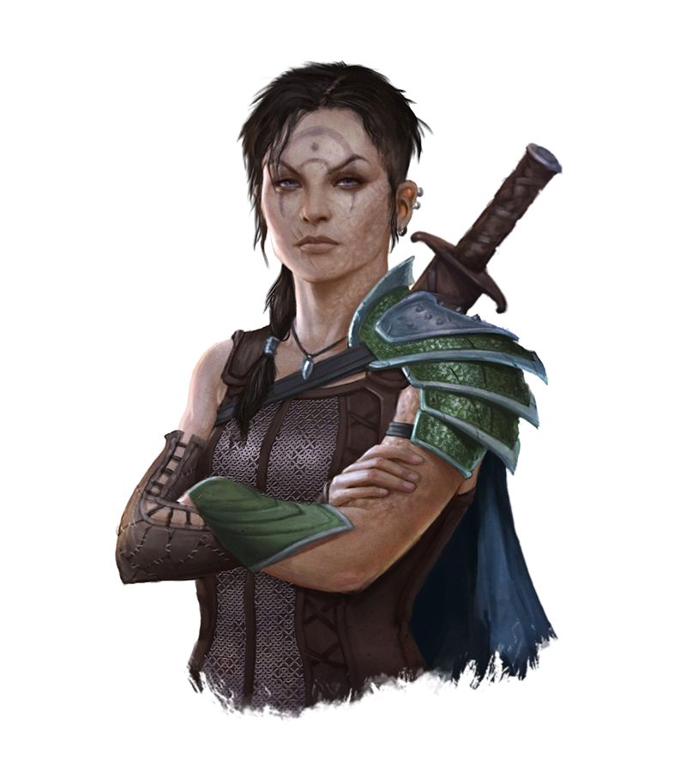
Akna Firahel
Half Elf
Head Guard of the Basinhold Prison.
Notes:
1 - Ostaram Dashkev (Governor)
2 - Akna Firahel (Head Guard)
3 - Colin Tallstag (Lawmaker)
4 - Lenett Laumee (Barkeeper)
5 - Ilikan Laumee (Bar Chef)
6 - Thalaman Laboda (Dealer/Croupier)
7 - Reddlepop Pilwicken (Head Chef)
8 - Pradir Nalambar (Inn Owner)
9 - Kuori Kalagiano (Blacksmith)
10 - Balifra Torevir (Magical Imbuer/Manipulator)
11 - Thervan Hanali (Magical Market Owner)
12 - Tanzim Hanali (Magical Market Son)
13 - Chand Avhoste (Bishop)
14 - Soveliss Pashar (Patriarch 1)
15 - Gennifer Caerdonel (Patriarch 2)
16 - Jabba (Nishi Waters Watcher)

Slide 3
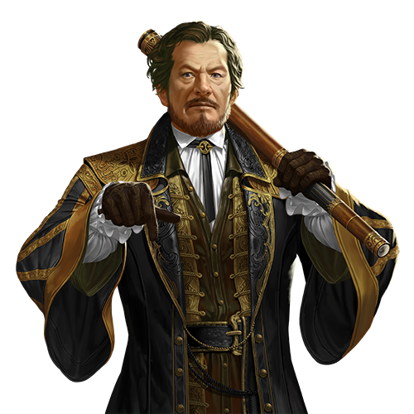
Colin Tallstag
Half Elf
The Lawmaker of Basinhold.
Notes:
1 - Ostaram Dashkev (Governor)
2 - Akna Firahel (Head Guard)
3 - Colin Tallstag (Lawmaker)
4 - Lenett Laumee (Barkeeper)
5 - Ilikan Laumee (Bar Chef)
6 - Thalaman Laboda (Dealer/Croupier)
7 - Reddlepop Pilwicken (Head Chef)
8 - Pradir Nalambar (Inn Owner)
9 - Kuori Kalagiano (Blacksmith)
10 - Balifra Torevir (Magical Imbuer/Manipulator)
11 - Thervan Hanali (Magical Market Owner)
12 - Tanzim Hanali (Magical Market Son)
13 - Chand Avhoste (Bishop)
14 - Soveliss Pashar (Patriarch 1)
15 - Gennifer Caerdonel (Patriarch 2)
16 - Jabba (Nishi Waters Watcher)

Slide 4
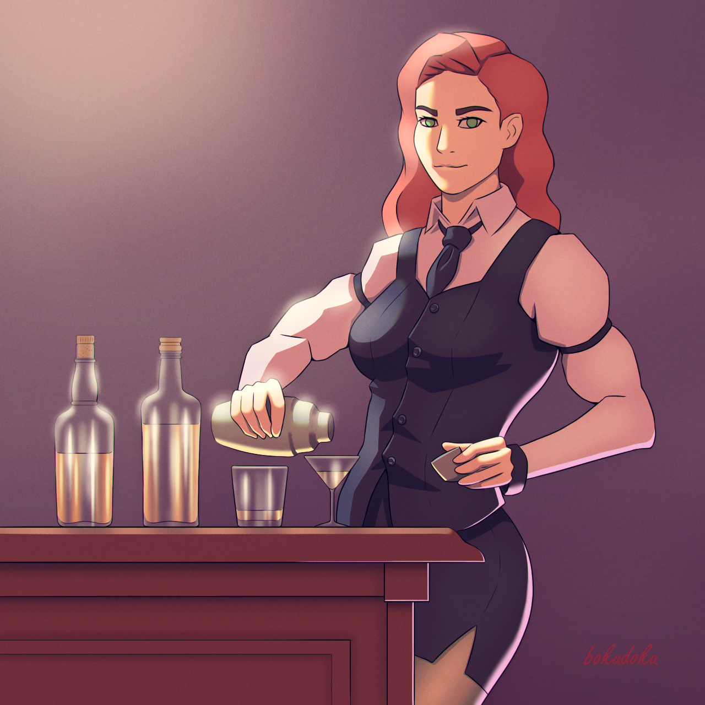
Lenett Laumee
Human
Barkeeper of the Eager Seals Drinking Hall.
Notes:
1 - Ostaram Dashkev (Governor)
2 - Akna Firahel (Head Guard)
3 - Colin Tallstag (Lawmaker)
4 - Lenett Laumee (Barkeeper)
5 - Ilikan Laumee (Bar Chef)
6 - Thalaman Laboda (Dealer/Croupier)
7 - Reddlepop Pilwicken (Head Chef)
8 - Pradir Nalambar (Inn Owner)
9 - Kuori Kalagiano (Blacksmith)
10 - Balifra Torevir (Magical Imbuer/Manipulator)
11 - Thervan Hanali (Magical Market Owner)
12 - Tanzim Hanali (Magical Market Son)
13 - Chand Avhoste (Bishop)
14 - Soveliss Pashar (Patriarch 1)
15 - Gennifer Caerdonel (Patriarch 2)
16 - Jabba (Nishi Waters Watcher)

Slide 5
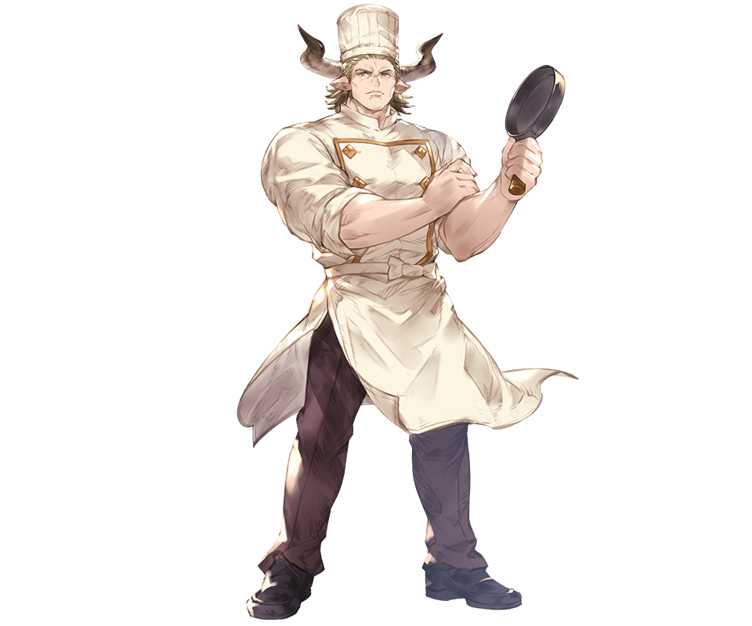
Ilikan Laumee
Half-Minotaur
Chef of the Eager Seals Drinking Hall.
Notes:
1 - Ostaram Dashkev (Governor)
2 - Akna Firahel (Head Guard)
3 - Colin Tallstag (Lawmaker)
4 - Lenett Laumee (Barkeeper)
5 - Ilikan Laumee (Bar Chef)
6 - Thalaman Laboda (Dealer/Croupier)
7 - Reddlepop Pilwicken (Head Chef)
8 - Pradir Nalambar (Inn Owner)
9 - Kuori Kalagiano (Blacksmith)
10 - Balifra Torevir (Magical Imbuer/Manipulator)
11 - Thervan Hanali (Magical Market Owner)
12 - Tanzim Hanali (Magical Market Son)
13 - Chand Avhoste (Bishop)
14 - Soveliss Pashar (Patriarch 1)
15 - Gennifer Caerdonel (Patriarch 2)
16 - Jabba (Nishi Waters Watcher)

Slide 6
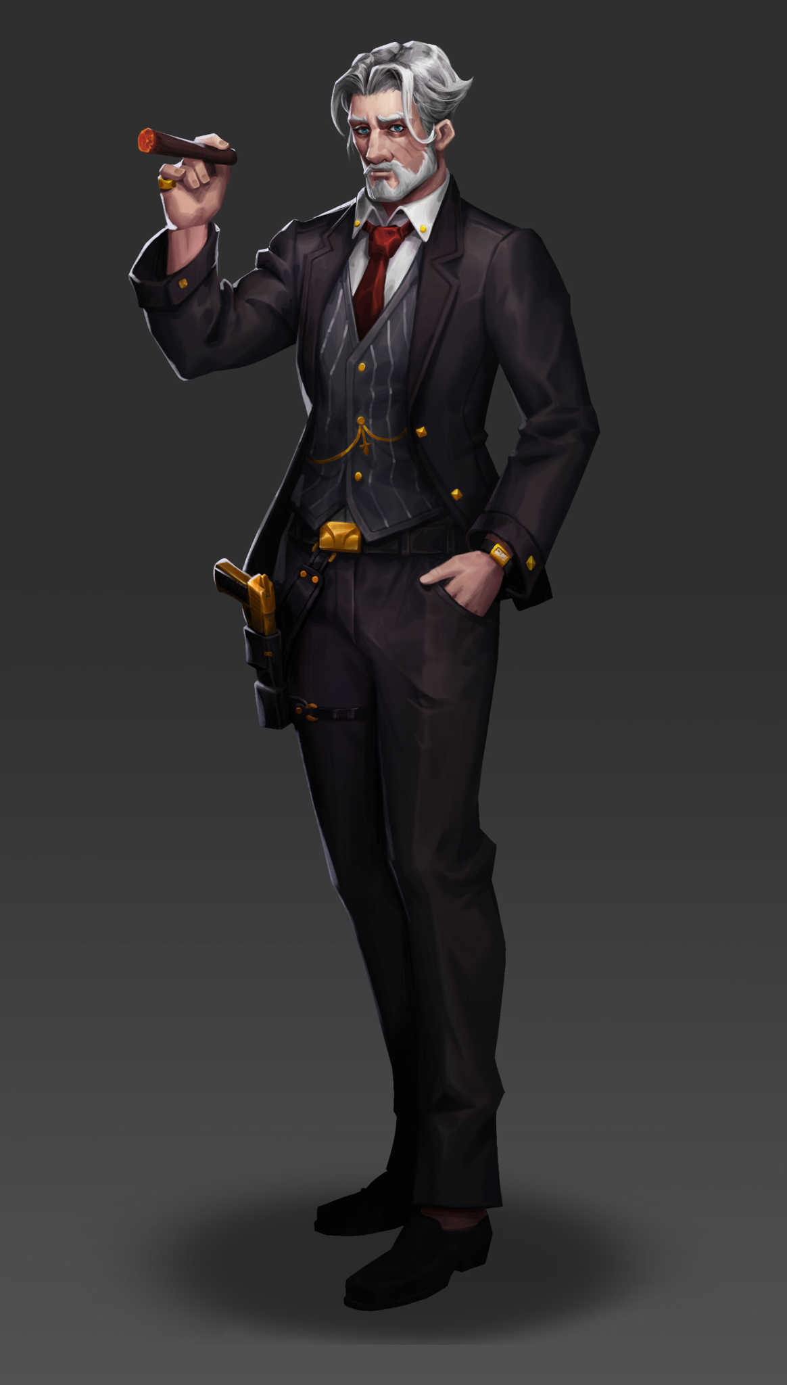
Thalaman Laboda
Human
Dealer of the Eager Seals Drinking Hall.
Notes:
1 - Ostaram Dashkev (Governor)
2 - Akna Firahel (Head Guard)
3 - Colin Tallstag (Lawmaker)
4 - Lenett Laumee (Barkeeper)
5 - Ilikan Laumee (Bar Chef)
6 - Thalaman Laboda (Dealer/Croupier)
7 - Reddlepop Pilwicken (Head Chef)
8 - Pradir Nalambar (Inn Owner)
9 - Kuori Kalagiano (Blacksmith)
10 - Balifra Torevir (Magical Imbuer/Manipulator)
11 - Thervan Hanali (Magical Market Owner)
12 - Tanzim Hanali (Magical Market Son)
13 - Chand Avhoste (Bishop)
14 - Soveliss Pashar (Patriarch 1)
15 - Gennifer Caerdonel (Patriarch 2)
16 - Jabba (Nishi Waters Watcher)

Slide 7

Reddlepop Pilwicken
Gnome
Head Chef of the Wild Grove Restaurant.
Notes:
1 - Ostaram Dashkev (Governor)
2 - Akna Firahel (Head Guard)
3 - Colin Tallstag (Lawmaker)
4 - Lenett Laumee (Barkeeper)
5 - Ilikan Laumee (Bar Chef)
6 - Thalaman Laboda (Dealer/Croupier)
7 - Reddlepop Pilwicken (Head Chef)
8 - Pradir Nalambar (Inn Owner)
9 - Kuori Kalagiano (Blacksmith)
10 - Balifra Torevir (Magical Imbuer/Manipulator)
11 - Thervan Hanali (Magical Market Owner)
12 - Tanzim Hanali (Magical Market Son)
13 - Chand Avhoste (Bishop)
14 - Soveliss Pashar (Patriarch 1)
15 - Gennifer Caerdonel (Patriarch 2)
16 - Jabba (Nishi Waters Watcher)

Slide 8
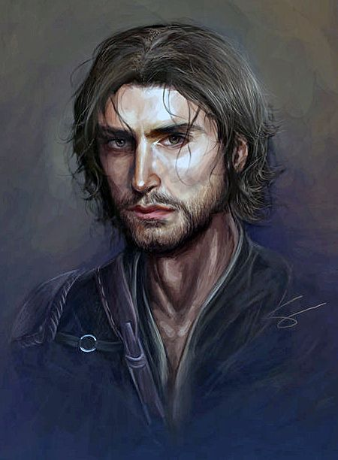
Pradir Nalambar
Human
Owner of the Private Traveler Inn.
Notes:
1 - Ostaram Dashkev (Governor)
2 - Akna Firahel (Head Guard)
3 - Colin Tallstag (Lawmaker)
4 - Lenett Laumee (Barkeeper)
5 - Ilikan Laumee (Bar Chef)
6 - Thalaman Laboda (Dealer/Croupier)
7 - Reddlepop Pilwicken (Head Chef)
8 - Pradir Nalambar (Inn Owner)
9 - Kuori Kalagiano (Blacksmith)
10 - Balifra Torevir (Magical Imbuer/Manipulator)
11 - Thervan Hanali (Magical Market Owner)
12 - Tanzim Hanali (Magical Market Son)
13 - Chand Avhoste (Bishop)
14 - Soveliss Pashar (Patriarch 1)
15 - Gennifer Caerdonel (Patriarch 2)
16 - Jabba (Nishi Waters Watcher)

Slide 9
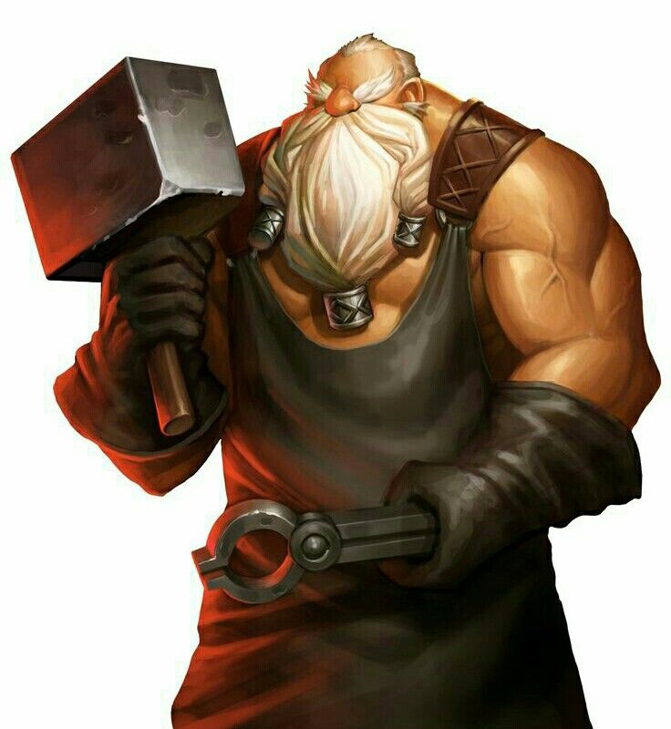
Kuori Kalagiano
Half Goliath
Blacksmith of the Adore Ore.
Notes:
1 - Ostaram Dashkev (Governor)
2 - Akna Firahel (Head Guard)
3 - Colin Tallstag (Lawmaker)
4 - Lenett Laumee (Barkeeper)
5 - Ilikan Laumee (Bar Chef)
6 - Thalaman Laboda (Dealer/Croupier)
7 - Reddlepop Pilwicken (Head Chef)
8 - Pradir Nalambar (Inn Owner)
9 - Kuori Kalagiano (Blacksmith)
10 - Balifra Torevir (Magical Imbuer/Manipulator)
11 - Thervan Hanali (Magical Market Owner)
12 - Tanzim Hanali (Magical Market Son)
13 - Chand Avhoste (Bishop)
14 - Soveliss Pashar (Patriarch 1)
15 - Gennifer Caerdonel (Patriarch 2)
16 - Jabba (Nishi Waters Watcher)

Slide 10
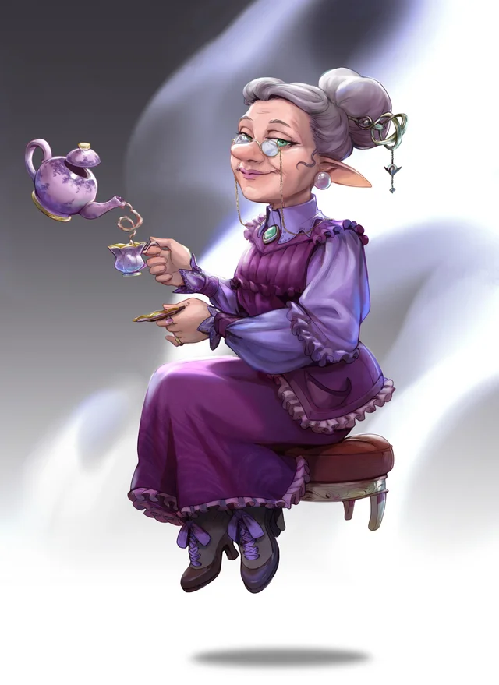
Balifra Torevir
Dwarf
The Magical Imbuer and Manipulator of the Adore Ore.
Notes:
1 - Ostaram Dashkev (Governor)
2 - Akna Firahel (Head Guard)
3 - Colin Tallstag (Lawmaker)
4 - Lenett Laumee (Barkeeper)
5 - Ilikan Laumee (Bar Chef)
6 - Thalaman Laboda (Dealer/Croupier)
7 - Reddlepop Pilwicken (Head Chef)
8 - Pradir Nalambar (Inn Owner)
9 - Kuori Kalagiano (Blacksmith)
10 - Balifra Torevir (Magical Imbuer/Manipulator)
11 - Thervan Hanali (Magical Market Owner)
12 - Tanzim Hanali (Magical Market Son)
13 - Chand Avhoste (Bishop)
14 - Soveliss Pashar (Patriarch 1)
15 - Gennifer Caerdonel (Patriarch 2)
16 - Jabba (Nishi Waters Watcher)

Slide 11
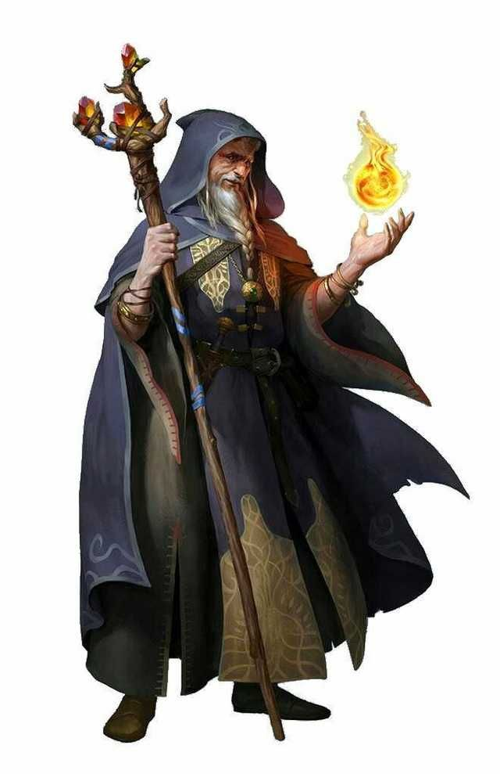
Thervan Hanali
Half Elf
The Owner of the Sweet Pond Magical Market
Notes:
1 - Ostaram Dashkev (Governor)
2 - Akna Firahel (Head Guard)
3 - Colin Tallstag (Lawmaker)
4 - Lenett Laumee (Barkeeper)
5 - Ilikan Laumee (Bar Chef)
6 - Thalaman Laboda (Dealer/Croupier)
7 - Reddlepop Pilwicken (Head Chef)
8 - Pradir Nalambar (Inn Owner)
9 - Kuori Kalagiano (Blacksmith)
10 - Balifra Torevir (Magical Imbuer/Manipulator)
11 - Thervan Hanali (Magical Market Owner)
12 - Tanzim Hanali (Magical Market Son)
13 - Chand Avhoste (Bishop)
14 - Soveliss Pashar (Patriarch 1)
15 - Gennifer Caerdonel (Patriarch 2)
16 - Jabba (Nishi Waters Watcher)

Slide 12
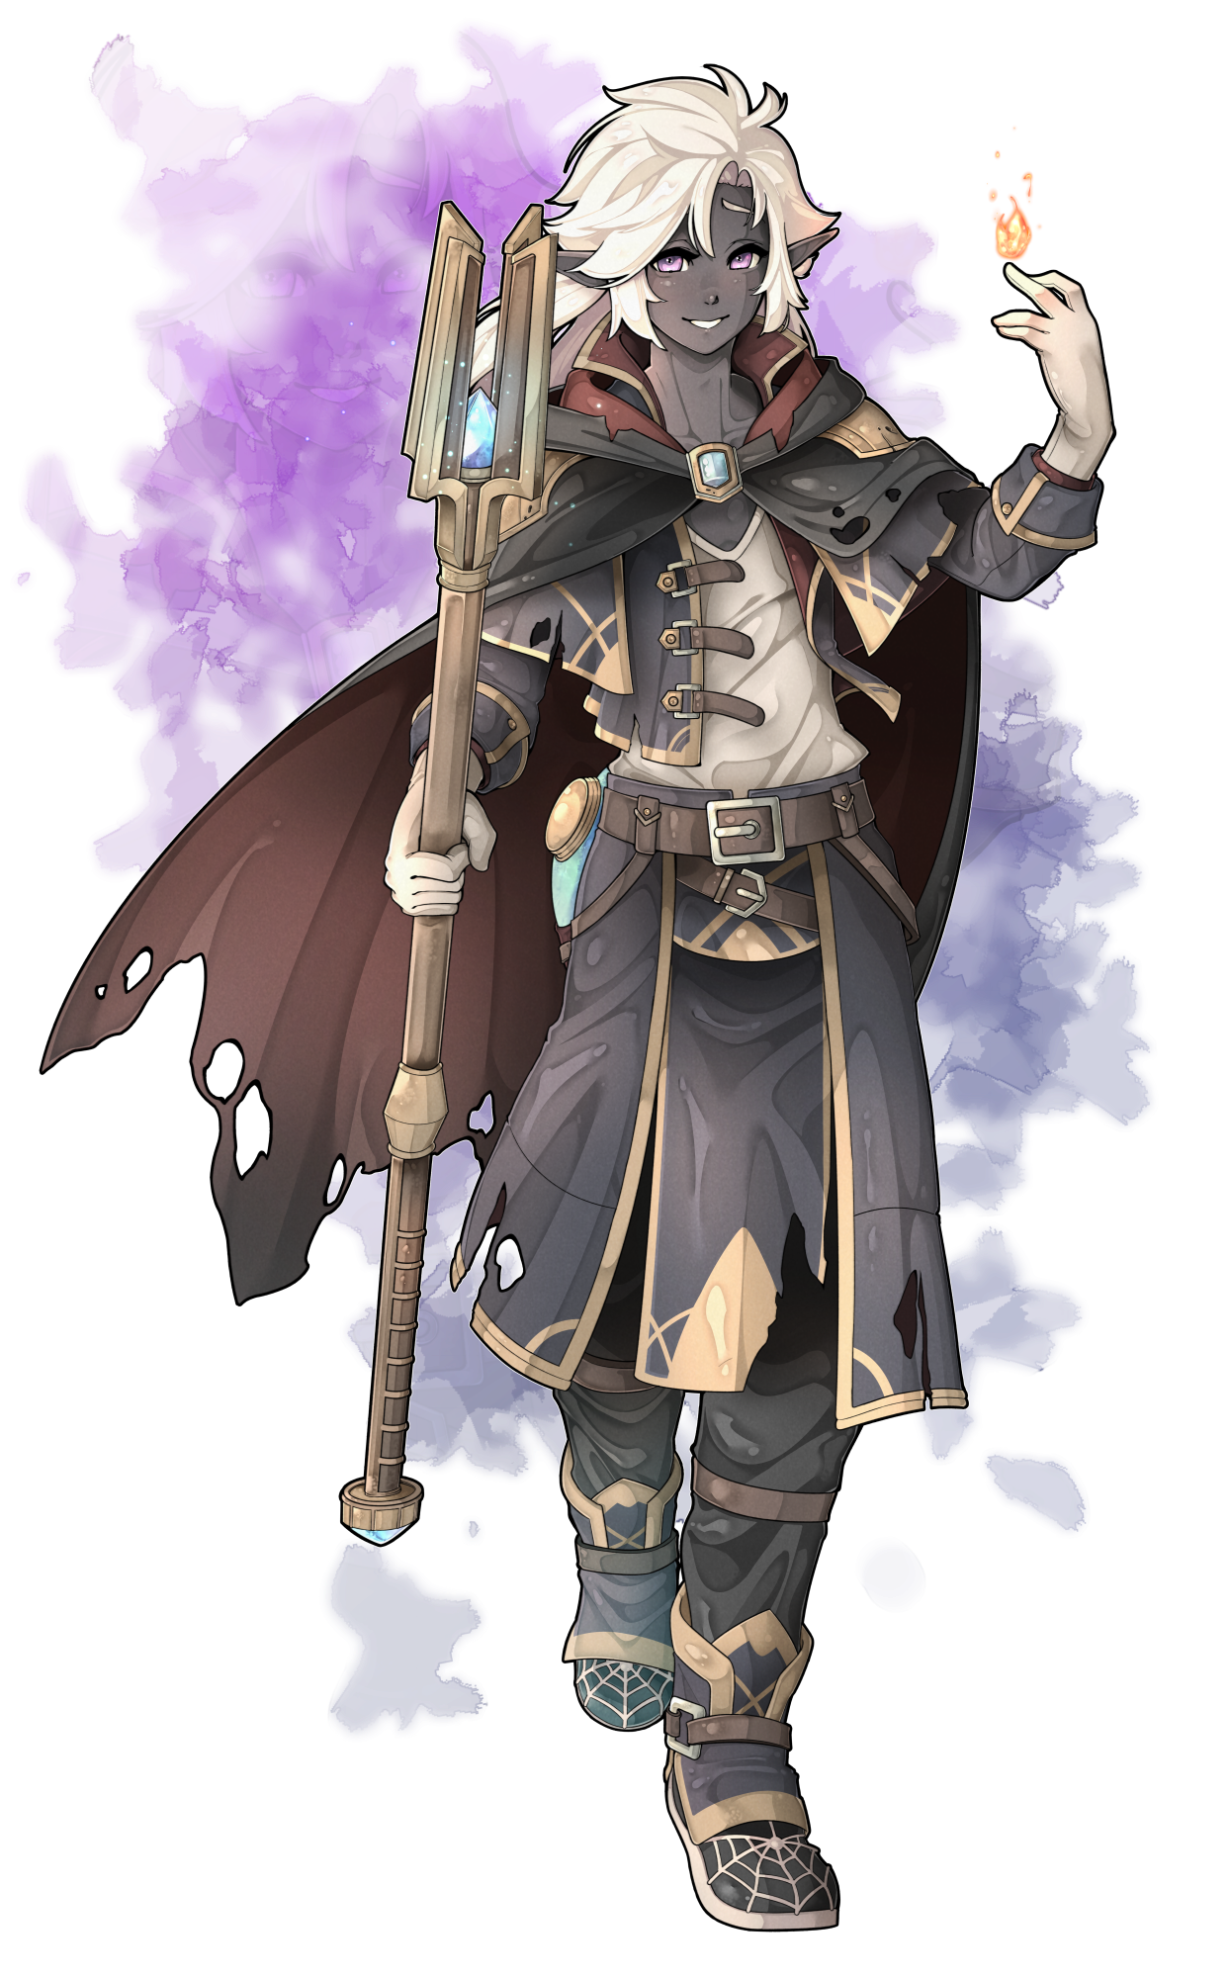
Tanzim Hanali
Half Elf (More Drow)
The Son of the Owner of the Sweet Pond Magical Market.
Notes:
1 - Ostaram Dashkev (Governor)
2 - Akna Firahel (Head Guard)
3 - Colin Tallstag (Lawmaker)
4 - Lenett Laumee (Barkeeper)
5 - Ilikan Laumee (Bar Chef)
6 - Thalaman Laboda (Dealer/Croupier)
7 - Reddlepop Pilwicken (Head Chef)
8 - Pradir Nalambar (Inn Owner)
9 - Kuori Kalagiano (Blacksmith)
10 - Balifra Torevir (Magical Imbuer/Manipulator)
11 - Thervan Hanali (Magical Market Owner)
12 - Tanzim Hanali (Magical Market Son)
13 - Chand Avhoste (Bishop)
14 - Soveliss Pashar (Patriarch 1)
15 - Gennifer Caerdonel (Patriarch 2)
16 - Jabba (Nishi Waters Watcher)

Slide 13
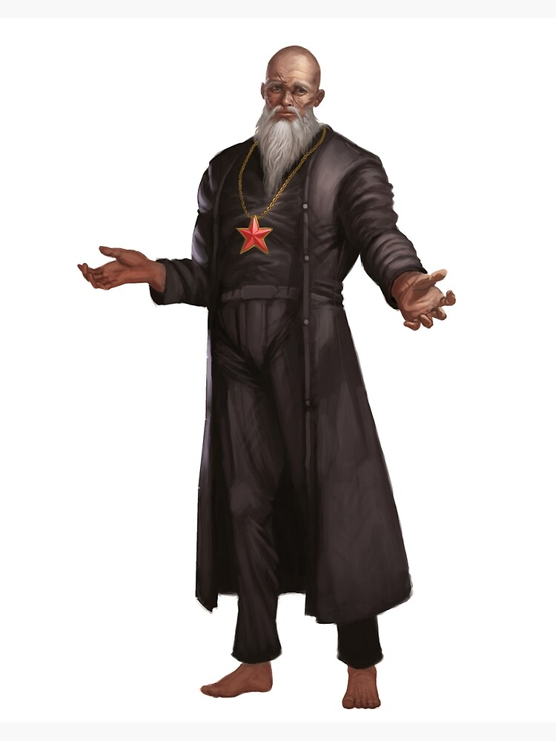
Chand Avhoste
Human
The Bishop of the Basinhold’s Church of Talos.
Notes:
1 - Ostaram Dashkev (Governor)
2 - Akna Firahel (Head Guard)
3 - Colin Tallstag (Lawmaker)
4 - Lenett Laumee (Barkeeper)
5 - Ilikan Laumee (Bar Chef)
6 - Thalaman Laboda (Dealer/Croupier)
7 - Reddlepop Pilwicken (Head Chef)
8 - Pradir Nalambar (Inn Owner)
9 - Kuori Kalagiano (Blacksmith)
10 - Balifra Torevir (Magical Imbuer/Manipulator)
11 - Thervan Hanali (Magical Market Owner)
12 - Tanzim Hanali (Magical Market Son)
13 - Chand Avhoste (Bishop)
14 - Soveliss Pashar (Patriarch 1)
15 - Gennifer Caerdonel (Patriarch 2)
16 - Jabba (Nishi Waters Watcher)

Slide 14
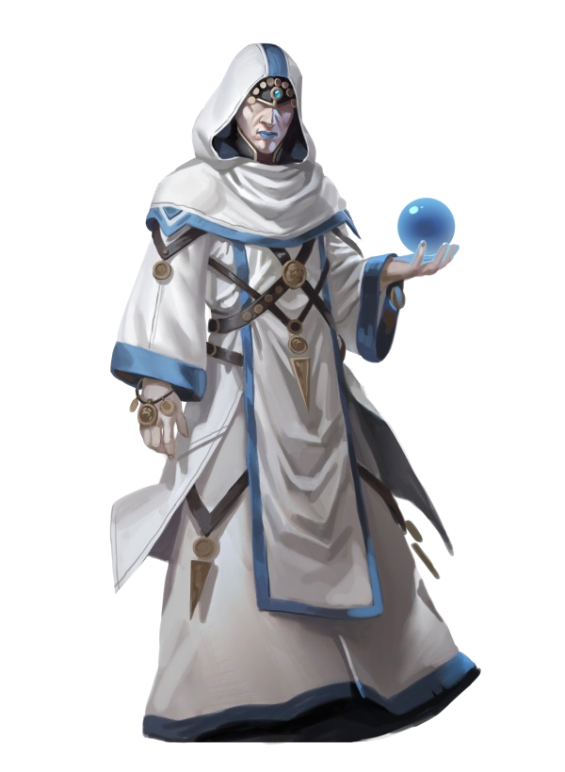
Soveliss Pashar
Half Elf
The Water and Air Patriarch of the Basinhold’s Church of Talos.
Notes:
1 - Ostaram Dashkev (Governor)
2 - Akna Firahel (Head Guard)
3 - Colin Tallstag (Lawmaker)
4 - Lenett Laumee (Barkeeper)
5 - Ilikan Laumee (Bar Chef)
6 - Thalaman Laboda (Dealer/Croupier)
7 - Reddlepop Pilwicken (Head Chef)
8 - Pradir Nalambar (Inn Owner)
9 - Kuori Kalagiano (Blacksmith)
10 - Balifra Torevir (Magical Imbuer/Manipulator)
11 - Thervan Hanali (Magical Market Owner)
12 - Tanzim Hanali (Magical Market Son)
13 - Chand Avhoste (Bishop)
14 - Soveliss Pashar (Patriarch 1)
15 - Gennifer Caerdonel (Patriarch 2)
16 - Jabba (Nishi Waters Watcher)

Slide 15
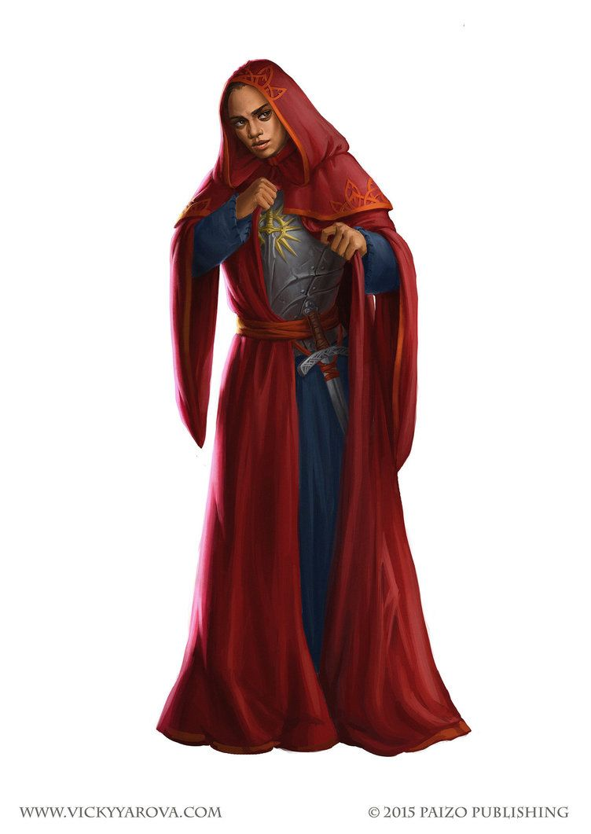
Gennifer Caedonel
Half Elf
The Fire and Earth Patriarch of the Basinhold’s Church of Talos.
Notes:
1 - Ostaram Dashkev (Governor)
2 - Akna Firahel (Head Guard)
3 - Colin Tallstag (Lawmaker)
4 - Lenett Laumee (Barkeeper)
5 - Ilikan Laumee (Bar Chef)
6 - Thalaman Laboda (Dealer/Croupier)
7 - Reddlepop Pilwicken (Head Chef)
8 - Pradir Nalambar (Inn Owner)
9 - Kuori Kalagiano (Blacksmith)
10 - Balifra Torevir (Magical Imbuer/Manipulator)
11 - Thervan Hanali (Magical Market Owner)
12 - Tanzim Hanali (Magical Market Son)
13 - Chand Avhoste (Bishop)
14 - Soveliss Pashar (Patriarch 1)
15 - Gennifer Caerdonel (Patriarch 2)
16 - Jabba (Nishi Waters Watcher)

Slide 16
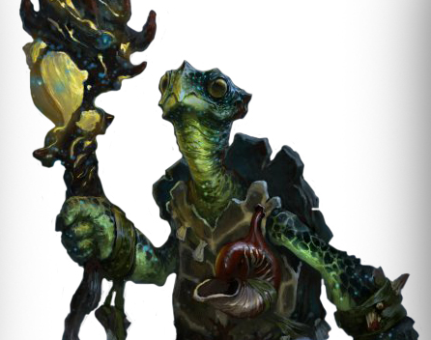
Jabba
Tortle
The watcher of the Nishi Waters, member of the Basinhold government.
Notes:
1 - Ostaram Dashkev (Governor)
2 - Akna Firahel (Head Guard)
3 - Colin Tallstag (Lawmaker)
4 - Lenett Laumee (Barkeeper)
5 - Ilikan Laumee (Bar Chef)
6 - Thalaman Laboda (Dealer/Croupier)
7 - Reddlepop Pilwicken (Head Chef)
8 - Pradir Nalambar (Inn Owner)
9 - Kuori Kalagiano (Blacksmith)
10 - Balifra Torevir (Magical Imbuer/Manipulator)
11 - Thervan Hanali (Magical Market Owner)
12 - Tanzim Hanali (Magical Market Son)
13 - Chand Avhoste (Bishop)
14 - Soveliss Pashar (Patriarch 1)
15 - Gennifer Caerdonel (Patriarch 2)
16 - Jabba (Nishi Waters Watcher)

